Slide 1

Chapter 2 :
Database Environment

Slide 2
Learning Outcomes
At the end of this chapter, students will be able to:
Describe ANSI/SPARC Architecture
Described roles in database environment
Described external, conceptual, internal schema
Describe data models
Functions of DBMS & DBMS environment

Slide 3
What is ‘Three Level ANSI-SPARC Architecture’ ?
In 1975 American National Standards Institute (ANSI) Standards Planning and Requirement Committee (SPARC) recognized the need for three level architecture.
The model provides the basis for understanding some of the functionality of a DBMS.

Slide 4
Objectives of Three-Level Architecture
All users should be able to access same data.
A user's view is immune to changes made in other views.
Users should not need to know physical database storage details.

Slide 5
Objectives of Three-Level Architecture
DBA should be able to change database storage structures without affecting the users' views.
Internal structure of database should be unaffected by changes to physical aspects of storage.
DBA should be able to change conceptual structure of database without affecting all users.

Slide 6
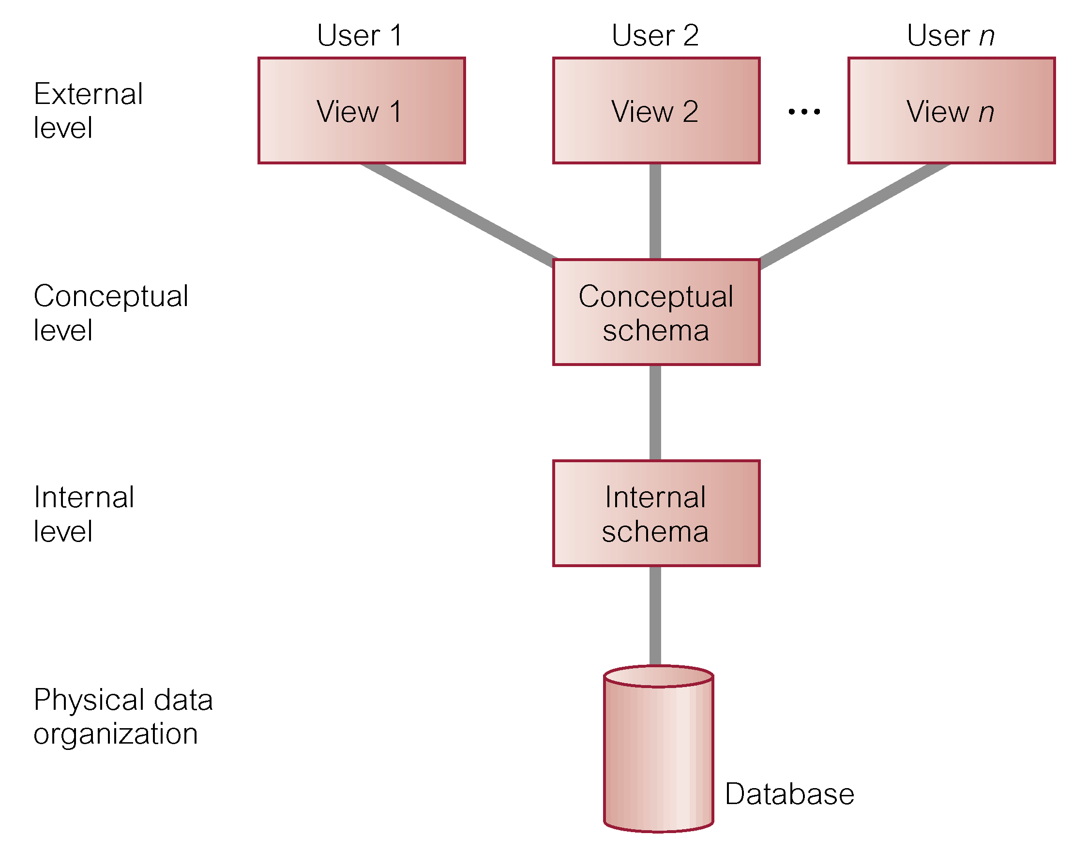
ANSI-SPARC Three-Level Architecture
ANSI - American National Standards Institute
SPARC - Standards Planning and Requirements Committee

Slide 7
External Level
  Users view of the database.
  Describes that part of database that is relevant to a particular user.
  Different views may have different representation of same data.
  For example, one user may view dates in the form (day, month, year), while another may view dates as (year, month, day).
  Some views might include derived or calculated data. (Example DOB → Age)

Slide 8
Conceptual Level
  Community view of the database.
  Describes what data is stored in database and relationships among the data.
  The conceptual level provides both the mapping and the desired independence between the external and internal levels
  The conceptual level supports each external view, in that any data available to a user must be contained in or derivable from the conceptual level.
  The conceptual level represents:
    All entities, their attributes and their relationships.
    The constraints on the data.
    Security and integrity information

Slide 9
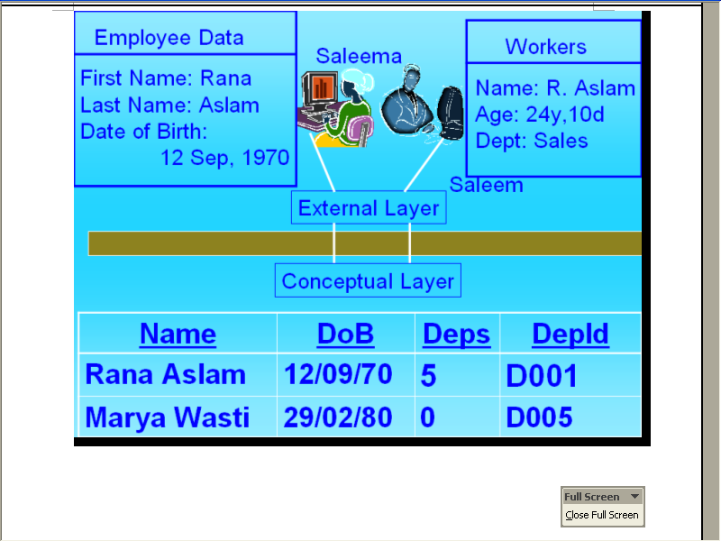
External & Conceptual Level

Slide 10
Internal Level
  Physical representation of the database on the computer.
  Describes how the data is stored in the database
  It covers the data structure and file organizations used to store data on storage devices.
  The internal level is concerned:
    Storage space allocation for data and indexes.
    Record descriptions for storage (with stored sizes for data items).
    Record placement.
    Data compression and data encryption techniques.

Slide 11
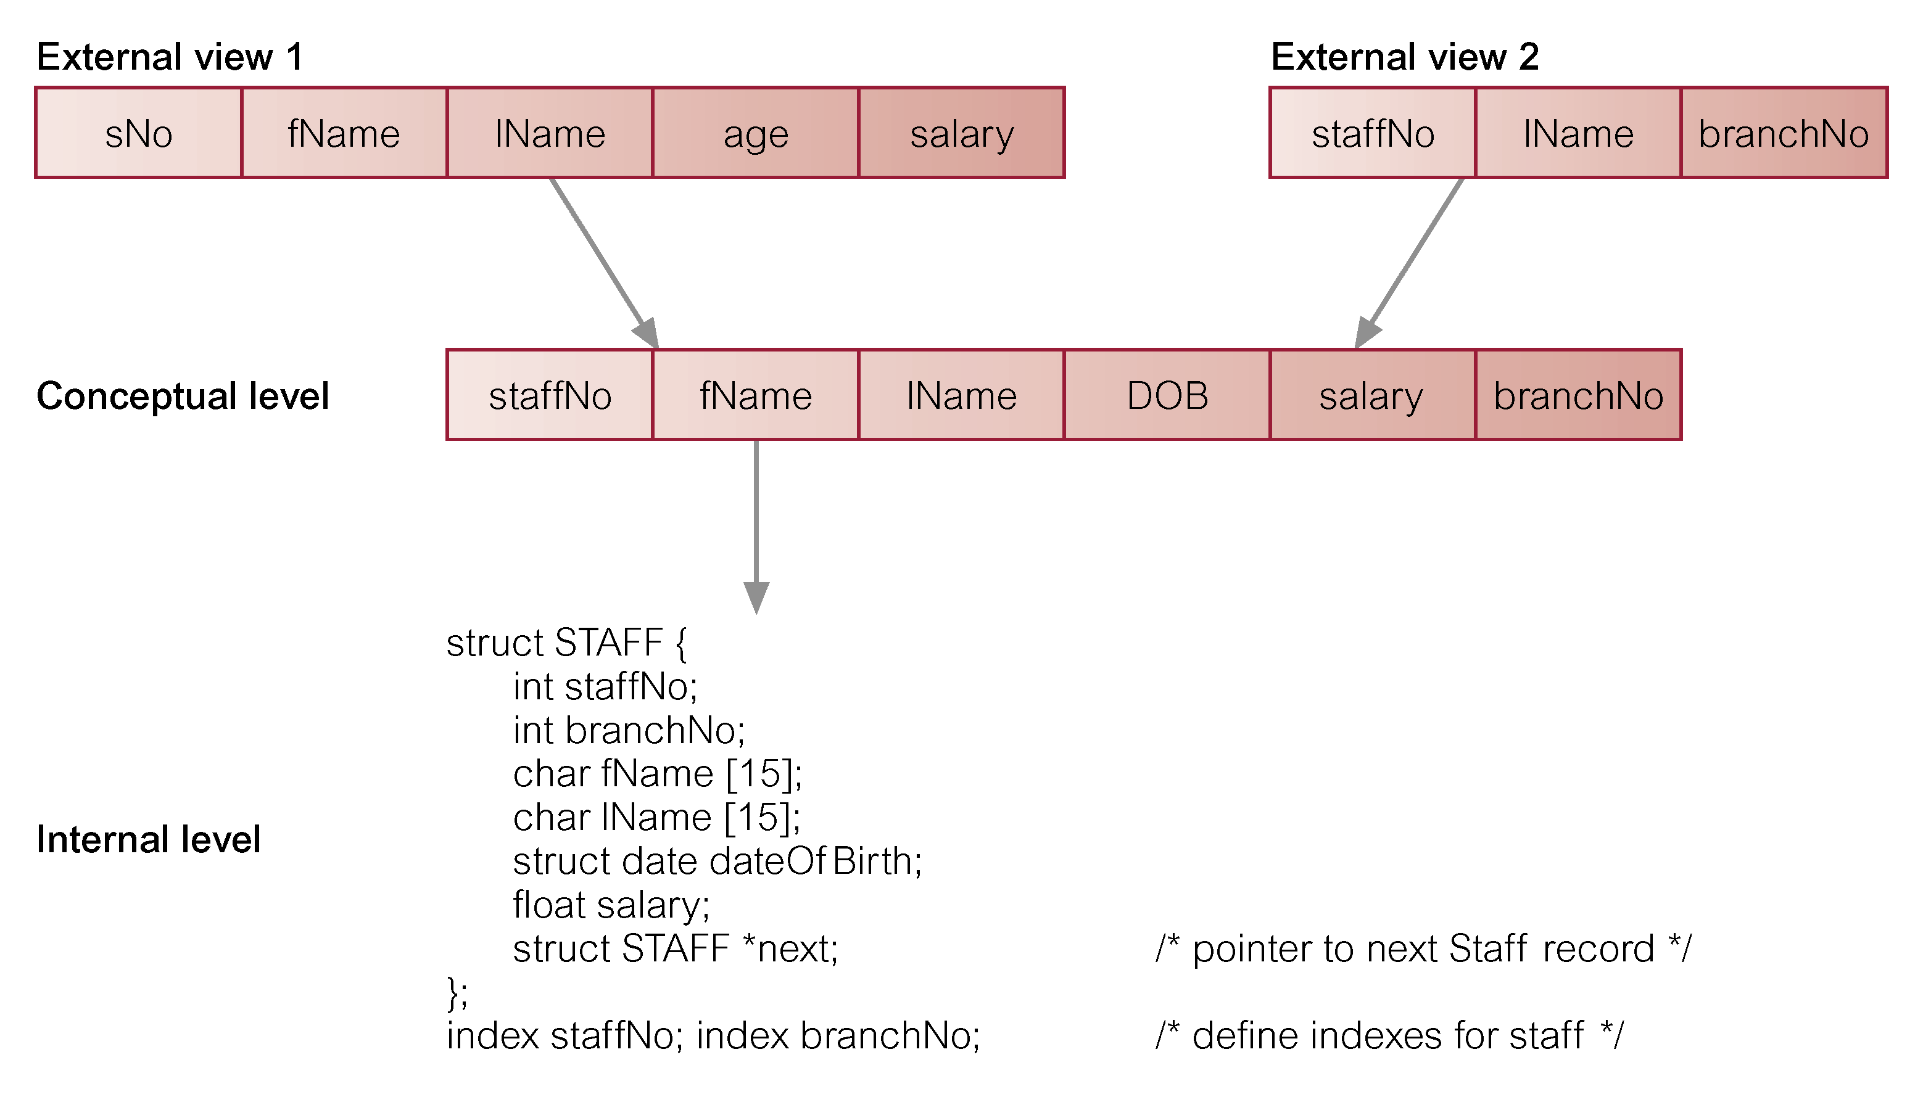
Differences between Three Levels of ANSI-SPARC Architecture

Slide 12
Database Schema
The overall description of the database is called the database schema.
The schema is specified during the database design process and is not expected to change frequently.
There are three different types of schema in the database. These are defined according to three level of architecture.

Slide 13
External Schema
At the highest level we have multiple external schemas (also called subschemas) that correspond to different views of data.

Slide 14
Conceptual Schema
At the conceptual level we have conceptual schema, which describe all the entities, attributes and relationships together with integrity constraints.

Slide 15
Internal Schema
At lowest level we have internal schema which is the complete description of internal model.
Containing the definition of stored record, the methods of representation, the data fields and indexes or hashing scheme.
There is only one conceptual schema and one internal schema per database.

Slide 16
Mappings
The DBMS is responsible for mapping between these three types of schema.
It must also check schemas for consistency.
Each external schema is derivable from the conceptual schema and it must use the information in the conceptual schema to map between each external schema and the internal schema

Slide 17
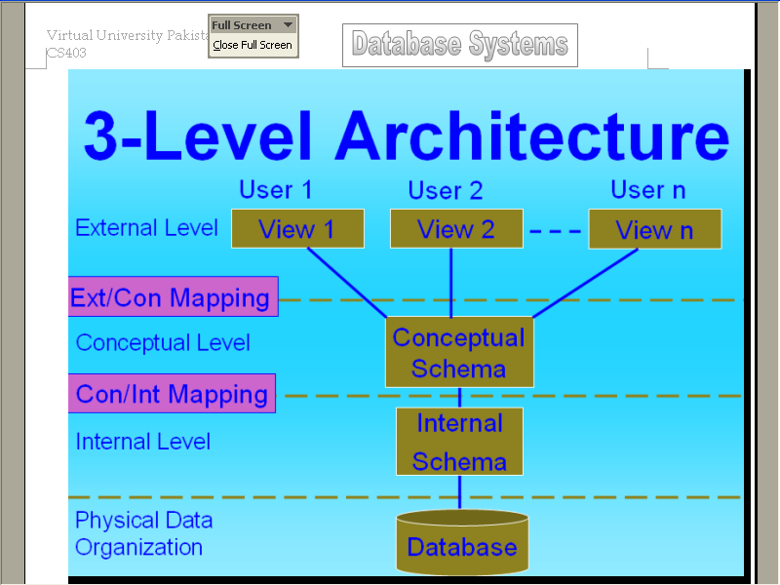
Mappings
The conceptual schema related to the internal schema through a conceptual/internal mapping.
External schema is related to the conceptual schema by the external/conceptual mapping.
Physical level is managed by OS under direction of DBMS.
Stored Record Interface B/w Int. & Physical Level, provided by OS to DBMS

Slide 18
Data Independence and the ANSI-SPARC Three-Level Architecture
A major objective for three-level architecture is to provide data independence.
Which means that upper levels are unaffected by changes to lower levels.
Data Independence: structure of organization and data format which are stored physically in storage are independent from its application.

Slide 19
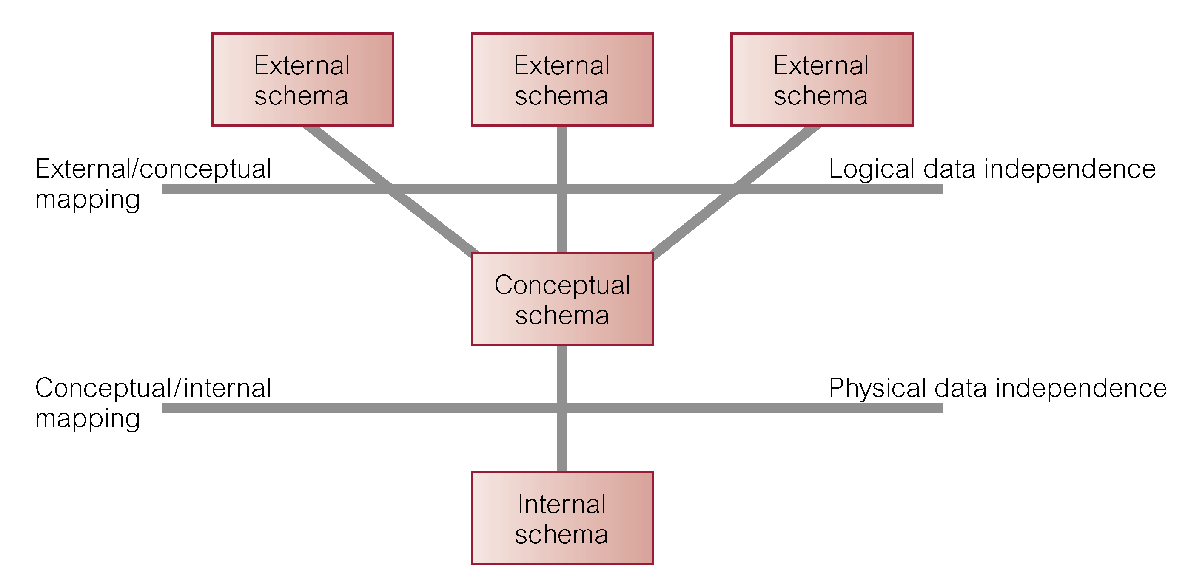
Data Independence and the ANSI-SPARC Three-Level Architecture

Slide 20
Data Independence
Logical Data Independence
  Refers to immunity of external schemas to changes in conceptual schema.
  Conceptual schema changes (e.g. addition/removal of entities).
  Should not require changes to external schema or rewrites of application programs.
Physical Data Independence
  Refers to immunity of conceptual schema to changes in the internal schema.
  Internal schema changes (e.g. using different file organizations, storage structures/devices).
  Should not require change to conceptual or external schemas.

Slide 21
Roles in the Database Environment
Data Administrator (DA)
Database Administrator (DBA)
Database Designers (Logical and Physical)
Application Programmers
End Users (naive and sophisticated)

Slide 22
Database Languages
Data Definition Language (DDL)
  Allows the DBA or user to describe and name entities, attributes, and relationships required for the application
  plus any associated integrity and security constraints.

Slide 23
Database Languages
Data Manipulation Language (DML)
  Provides basic data manipulation operations on data held in the database.
Procedural DML
  allows user to tell system exactly how to manipulate data.
Non-Procedural DML
  allows user to state what data is needed rather than how it is to be retrieved..

Slide 24
Database Languages
Fourth Generation Language (4GL)
  Query Languages
  Forms Generators
  Report Generators
  Graphics Generators
  Application Generators

Slide 25
Data Model
Integrated collection of concepts for describing data, relationships between data, and constraints on the data in an organization.
Data Model comprises:
  a structural part;
  a manipulative part;
  possibly a set of integrity rules.
Purpose
  To represent data in an understandable way.

Slide 26
Data Models
Categories of data models include:
  Object-based
  Record-based
  Physical.
Object-Based Data Models
  Entity-Relationship
  Semantic
  Functional
  Object-Oriented.

Slide 27
Data Models
Record-Based Data Models
  Relational Data Model
  Network Data Model
  Hierarchical Data Model.
Physical Data Models

Slide 28
Functions of a DBMS
1) Data Storage, retrieval and update
A DBMS must furnish users with the ability to store, retrieve and update data in the database.
2) A user accessible catalog
A DBMS must furnish a catalog in which descriptions of data items are stored and which is accessible to users.
3) Transaction Support
A DBMS must furnish a mechanism which will ensure that all the updates corresponding to a given transaction are made or that none of them is made.

Slide 29
Functions of a DBMS
4) Concurrency control services
A DBMS must furnish a mechanism to ensure that the database is update correctly when multiple users are updating the database concurrently
5) Recovery Services
A DBMS must furnish a mechanism for recovering the database in the event that the database is damaged in any way.
6) Authorization Services
A DBMS must furnish a mechanism to ensure that only authorized users can access the database.

Slide 30
Functions of a DBMS
7) Support for data communication
A DBMS must be capable of integrating with communication software.
8) Integrity services
A DBMS must furnish a means to ensure that both the data in the database and changes to the data follow certain rules.
9) Services to support data independence
A DBMS must include facilities to support the independence of programs from the actual structure of the database.

Slide 31
Functions of a DBMS
10) Utility Services
A DBMS should provide a set of utility services.
Import and Export facilities
Monitoring database facilities
Examine database performance

Slide 32
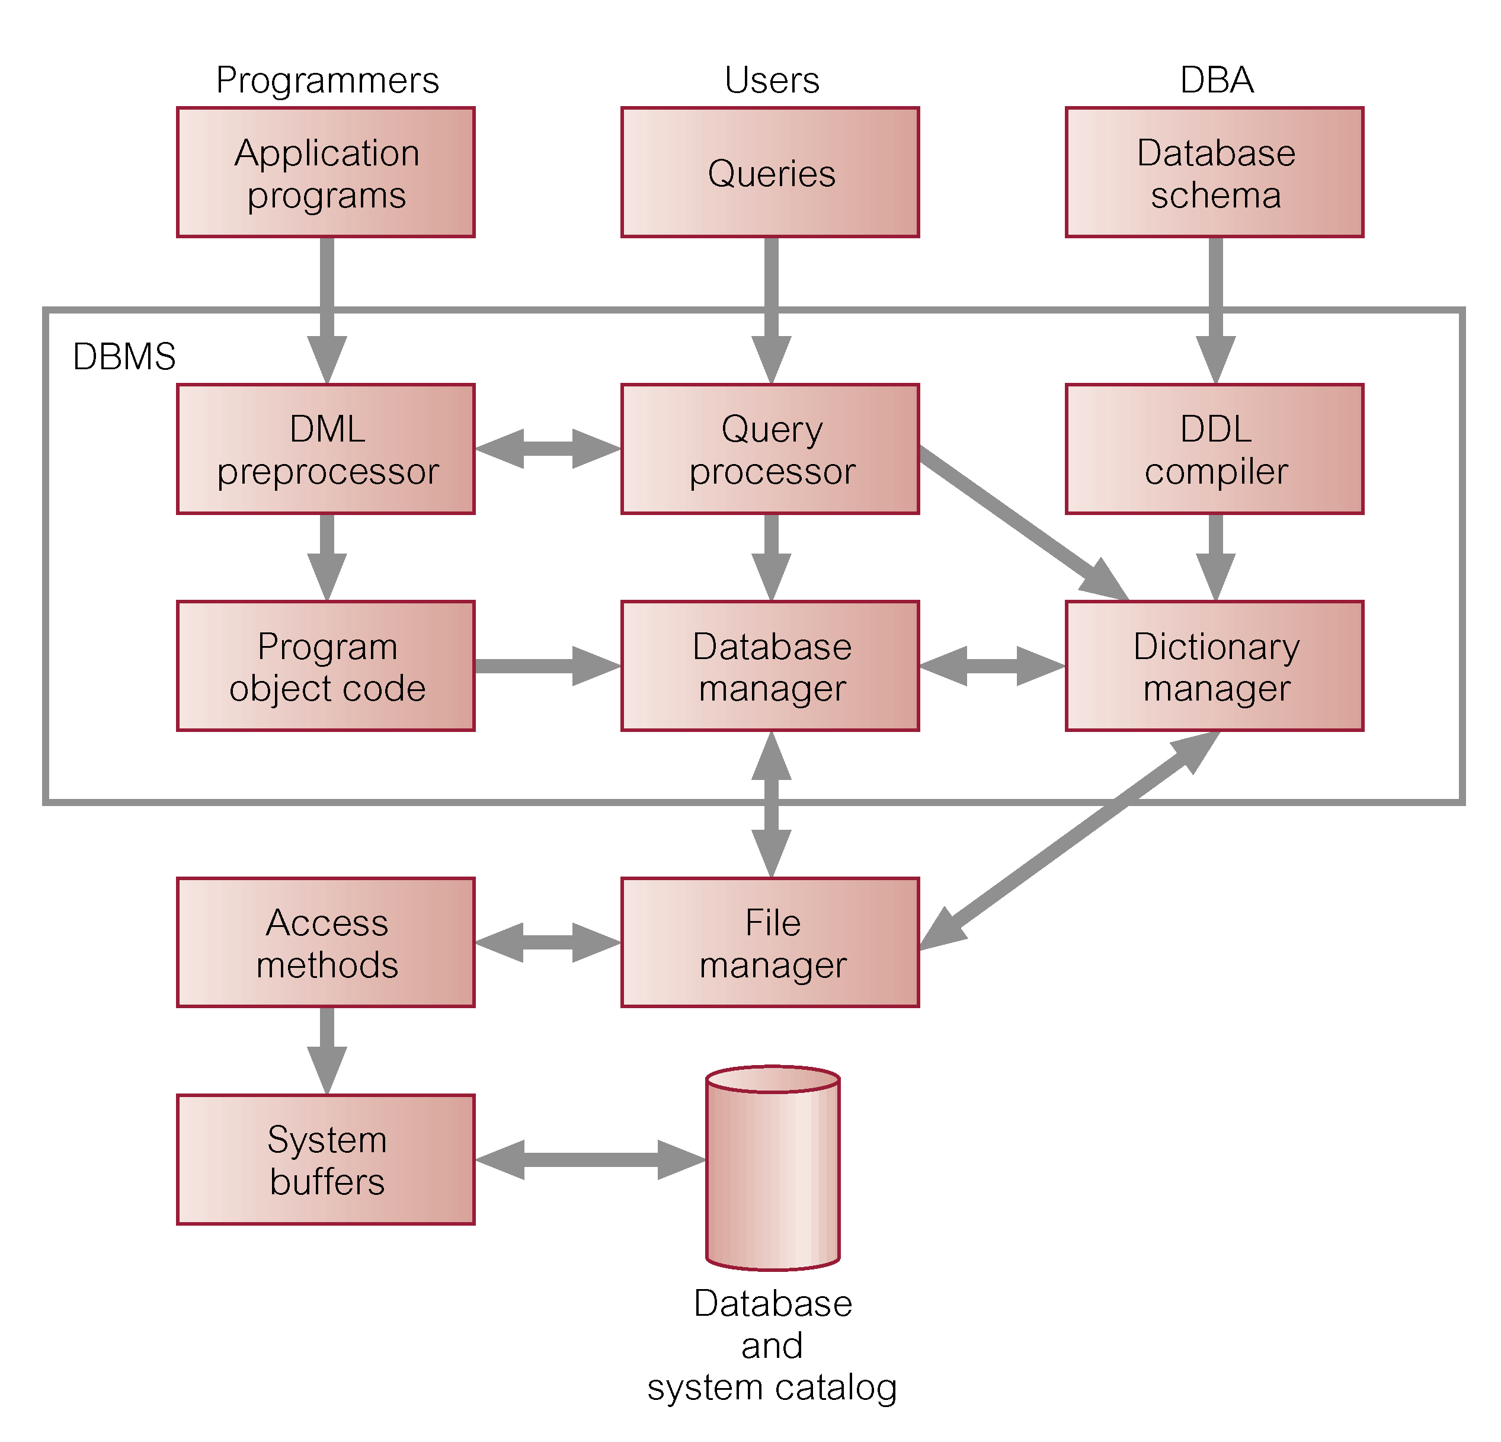
Components of a DBMS

Slide 33
DBMS Environments
Single User Database Environment :
The database environment which supports only one user accessing the database at a specific time.
The DBMS might have a number of users but at a certain time only one user can log into the database system and use it.
This type of DBMS systems are also called Desktop Database systems.

Slide 34
DBMS Environments
Multi-User Database systems:
The DBMS which can support a number of users simultaneously interacting with the database indifferent ways. A number of environments exist for such DBMS.
  Teleprocessing
  File Servers
  Client-Server

Slide 35
DBMS Environments
Teleprocessing:
Processes the user requests at a central computer, all requests are carried to the central computer where the database is residing, transactions are carried out and the results transported back to the terminals (literally dumb terminals). It has become obsolete now.

Slide 36
DBMS Environments
File-Server:
A file server is used to maintain a connection between the users of the database system.
Each client of the network runs its own copy of the DBMS and the database resides on the file server.
Whenever user needs data from the file server it makes a request the whole file containing the required data was sent to the client.
Now if the client after making the desired operation on the desired data wants to write back the data on the database he will have to send the whole file back to the server, thus causing a lot of network overhead.
The Good thing about this approach is that the server does not have lots of actions to do.

Slide 37
DBMS Environments
Client-Server:
It has a DBMS server machine which runs the DBMS and this machine are connected to the clients having application programs running for each user.
When users wants to perform a certain operation on data in the database it sends requests to the DBMS through machine’s application software
Request is forwarded to the DBMS server which performs the required operation on data in the database stored in the computer and then passes back the result
This environment is best suited for large enterprises where bulk of data is processed and requests are very much frequent.

Slide 38

END OF CHAPTER 2

